Slide 1
Facilities Perspective Alternative Academic Calendar Committee
Instructional Week – 70 hours per week ( 8:00 am to 10:00 pm)
Lecture Room Schedules – 53 hours per week usage
Lab Room Schedules – 27.5 hours per week usage
Capacity Load Ratios – Assignable Square Footage / Student Capacity
100% Cap Load indicates balanced with students and built facilities
Below 100% Cap Load qualifies for State Funded Projects (when funding is available)
Assumes 100% of instruction occurs in-person on-campus
Board of Governors of the California Community Colleges Policy on Utilization and Space Standards - 2020 revision
2024-25 Academic Year | Chabot College | Las Positas College
Lecture (20 asf/student) | 183% | 174%
Lab (50 asf/student) | 132% | 125%
Office (175 asf per FTEF) | 108% | 109%
Library | 116% (154%) | 121%
AV/TV | 89% | 30%

Slide 2
Alternative Academic Calendar Committee
Instructional capacity for any one class period if all rooms are used:
Weekly instructional capacity based upon available hours per week:
2022-23 Academic Year | Chabot College | Instructional Total Capacity | Las Positas College | Total Capacity
Lecture Rooms | 68 | 7,870 students | 55 | 6,838 students
Lab Rooms | 84 | 2,978 students | 62 | 1, 902 students
Total | 152 | 10,848 students | 117 | 8,740 students
2022-23 Academic Year | Chabot College | Weekly Instructional Capacity | Las Positas College | Weekly Instructional Capacity
Lecture Rooms |  | 417,110 WSCH |  | 362,414 WSCH
Lab Rooms |  | 81,895 WSCH |  | 52,305 WSCH
Total |  | 499,005 WSCH |  | 414,719 WSCH

Slide 3
Alternative Academic Calendar Committee
Definitions, Abbreviations and Explanations:
asf – Assignable Square Footage (clear floor area within a room)
FTEF – Full Time Equivalent Faculty Member (calculation method assumes that assigned square footage will include administrative office, classified workspace, work rooms, storage room and meeting rooms)
AV/TV – Audio Visual / Television instructional spaces including recording and podcast spaces.
Instructional Total Capacity – sum of all rooms within the category with room assignments based upon input taxonomy of program (room assignments: ie – Biology lab, Computer Lab, Lecture classroom) A point in time count, class length effects the total capacity of the college.
WSCH –Weekly Student Contact Hours available at each campus by type of instruction and hours of usage for each room type.

Slide 4
Maintenance and Operations Perspective Alternative Academic Calendar Committee
Custodial
Staff work three different shift and clean office, common areas and available instructional spaces when they are available based upon each semester data input into the 25Live scheduling software.
Maintenance
Staff work two shifts (days and swing shift) to address issues and make necessary repairs based upon observation and reported items via the work order system (instructional room work traditionally 6:00 am to 9:00 am or during break in schedule)
Grounds
Staff work day shift only, traditionally complete work on the interior of campus between 6:00 am and 9:00 am , and perform other less noisy work during the instructional day
Overall the academic calendar and events calendars for each campus do not have a period of time when significant disruption to the power system or the Heating/Cooling systems can be performed. Shut downs for emergency occur as necessary, scheduled shut downs are often performed on overtime by staff on the weekends (Sunday). Additional non-instructional weeks may allow additional preventative work to be done not on overtime hours.

Slide 5
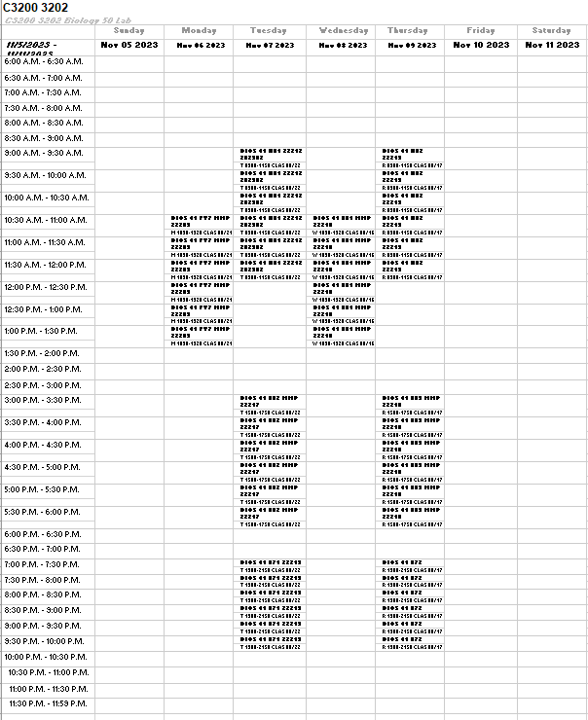
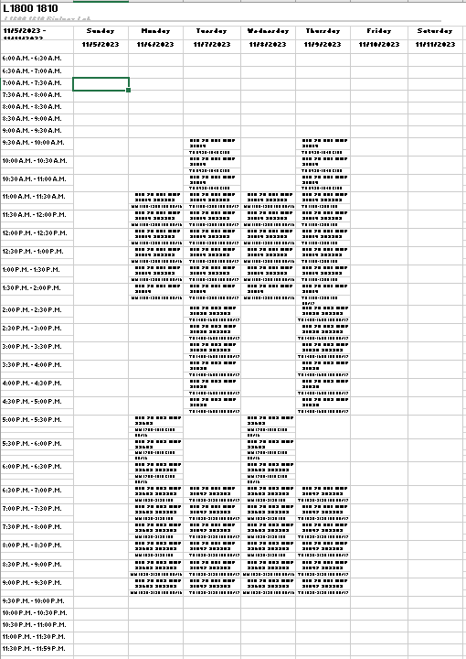
Maintenance and Operations Perspective Alternative Academic Calendar Committee
Current 25Live Data: random selected Lab Spaces at CC & LPC

Slide 6
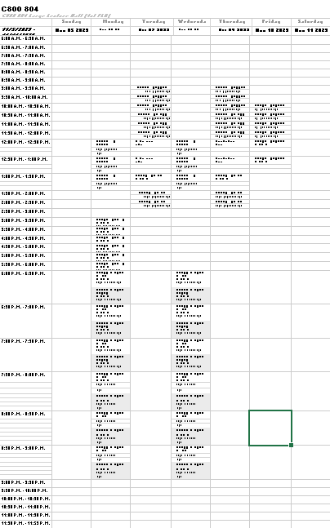
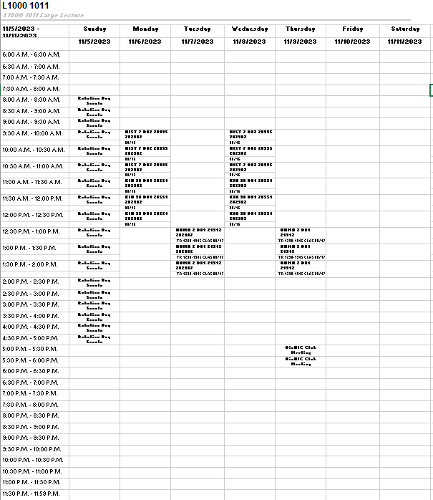
Maintenance and Operations Perspective Alternative Academic Calendar Committee
Current 25Live Data: random selected Lecture Spaces at CC & LPC

