Slide 1
Compressed Calendar Forum
CHABOT
LAS POSITAS
COMMUNITY COLLEGE DISTRICT
Alternative Academic Calendar Committee (AACC)
Chabot College
Las Positas College
District Office

Slide 2
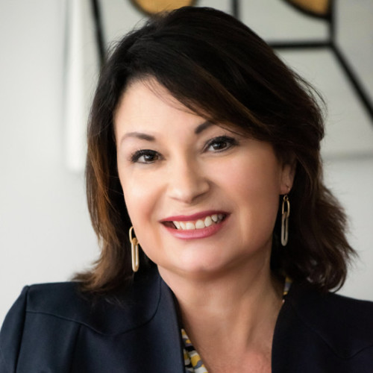
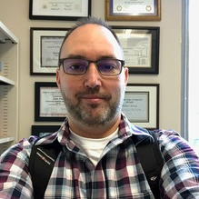
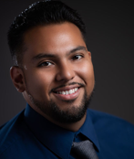
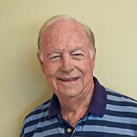
Presenters
Theresa Fleischer Rowland
Jason Ames
David Rodriguez
John Mullen
Vice Chancellor Educational Services & Student Success CLPCCD
Instructor Communications Studies Chabot College
Research Analyst Las Positas College
Senior Consultant California Community Colleges

Slide 3
Why are we considering a compressed calendar for Chabot College and Las Positas College?

Slide 4
Agenda
What is a compressed calendar?
How are classes scheduled under a compressed calendar?
Alternative Academic Calendar Committee (AACC)
Key steps in deciding on whether to pursue a compressed calendar for Chabot and Las Positas Colleges
Recommendation to the District Chancellor

Slide 5
Compressed Calendar Project Information
Detailed current information about this project is available on the Alternative Academic Calendar Committee website: https://clpccd.org/altcalcommittee/
Questions and comments from students, faculty, classified professionals and administrators are welcomed.
Use this feedback form: https://tinyurl.com/AACCform or scan this QR code:

Slide 6
What is a compressed academic calendar?
California Community College regulations permit colleges to compress the same number of hours of instruction into shorter semesters by slightly increasing the number of minutes per class session.

Slide 7
Two Types of Academic Calendar
TRADITIONAL
COMPRESSED
Chabot College and Las Positas College now operate on a traditional academic calendar.
The current calendar has a total of 35 weeks of instruction and examination in the two semesters of the academic year.
The semesters average 17.5 weeks in length.
Many California community colleges have moved to a compressed academic calendar.
A typical compressed calendar has 32 weeks of instruction, with the academic year having two 16-week semesters.
Summer and other intersession courses may be offered as well.

Slide 8
Academic Calendars at Nearby Institutions
The Fall 2023 semester at UC Berkeley has 14 weeks of classroom instruction and 1 week of final examinations.
At Cal State East Bay, San Francisco State, and San José State, the Fall 2023 semester has 15 weeks of classroom instruction and 1 week of final examinations.
Diablo Valley College, Contra Costa College, Los Medanos College and Ohlone College all have the same type of calendar that is being discussed as a possibility for Chabot and Las Positas Colleges, with 15 weeks of classroom instruction and 1 week of final examinations.

Slide 9
How does class scheduling work under a compressed calendar?
SAME TOTAL NUMBER OF HOURS OF INSTRUCTION FOR EACH COURSE
Because the semester has fewer class meetings, the length of each meeting is increased by a few minutes.
For example, consider a 3-unit lecture course:
TRADITIONAL COMPRESSED 2 meetings per week 2 meetings per week
MW 1:00 – 2:15 MW 1:00 – 2:25

Slide 10
How does class scheduling work under a compressed calendar?
On a traditional calendar, a full-semester 3-unit lecture course would typically be scheduled with:
Two meetings per week of 1 hour and 15 minutes, OR
One meeting per week of 2 hours and 50 minutes.
On a compressed calendar with 16-week semesters, this course would be scheduled with:
Two meetings per week of 1 hour and 25 minutes, OR
One meeting per week of 3 hours and 10 minutes.

Slide 11
How does class scheduling work under a compressed calendar?
As another example, consider a 4-unit chemistry course that is now scheduled with 3 hours of lecture and 3 hours of laboratory each week of a full semester: Lecture MW 12:00 - 1:15 Lab M 1:30 - 4:20
Under a compressed calendar with 16-week semesters, the course might be scheduled as: Lecture MW 12:00 – 1:25 Lab M 1:30 – 4:40

Slide 12
How does class scheduling work under a compressed calendar?
Finally, consider a 2-unit welding skills laboratory course that is now scheduled with two sessions each week of a full semester: Lab M 3:30 – 6:45 (3.5 contact hours) AND Lab W 4:30 – 6:45 (2.5 contact hours)
Under a compressed calendar with 16-week semesters, the course might be scheduled as: Lab M 3:30 – 7:05 (3.9 contact hours) AND Lab W 4:30 – 7:00 (2.8 contact hours)

Slide 13
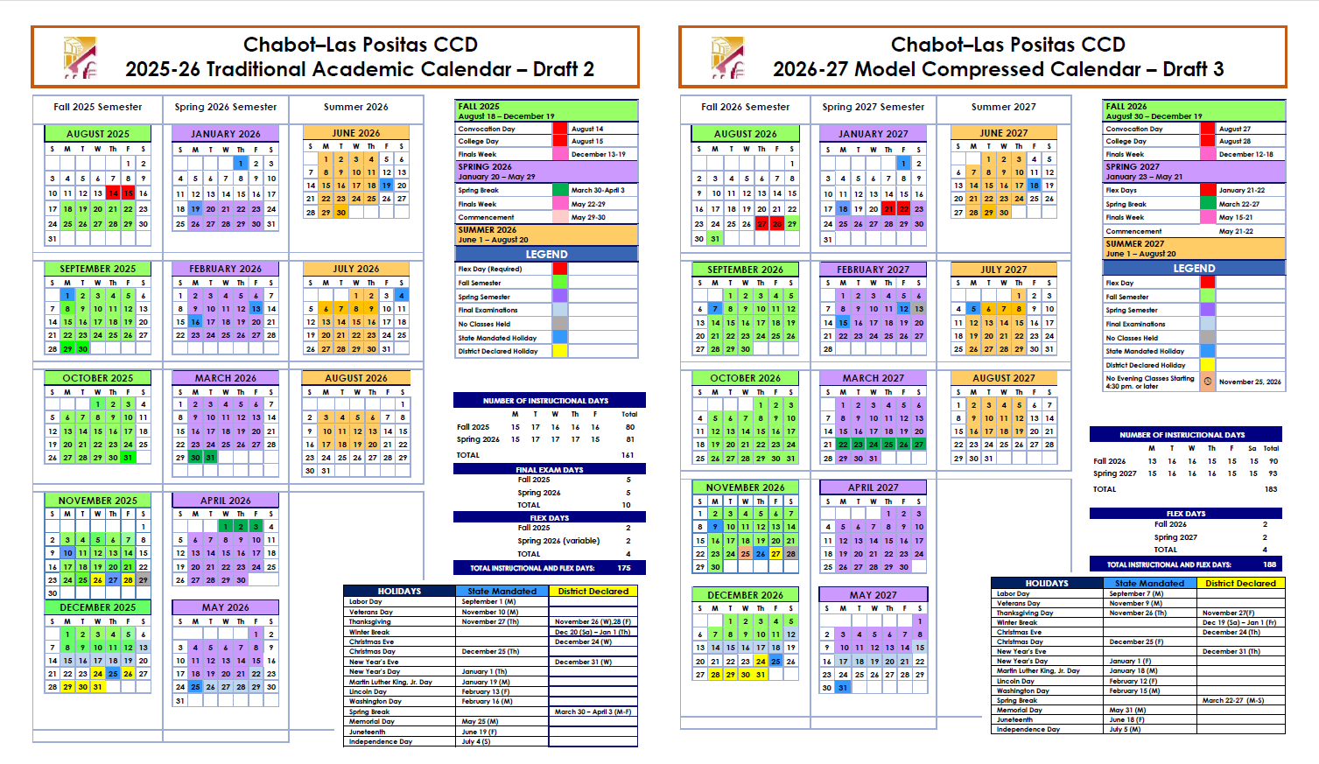
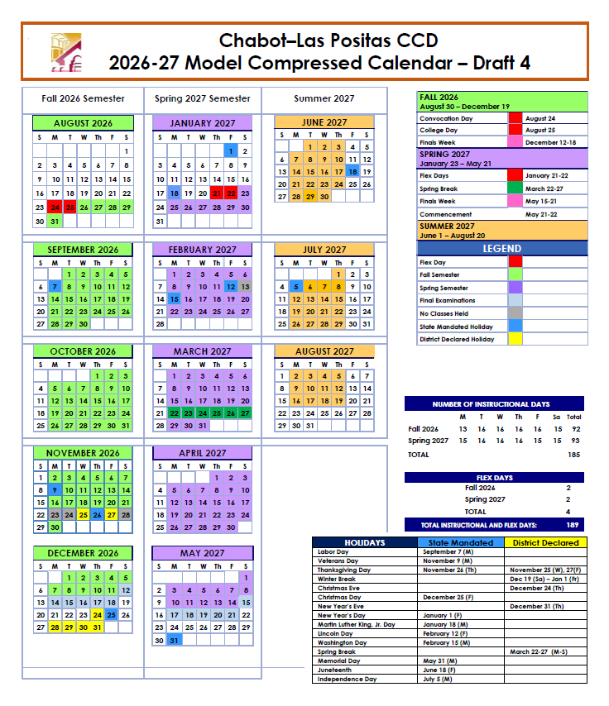
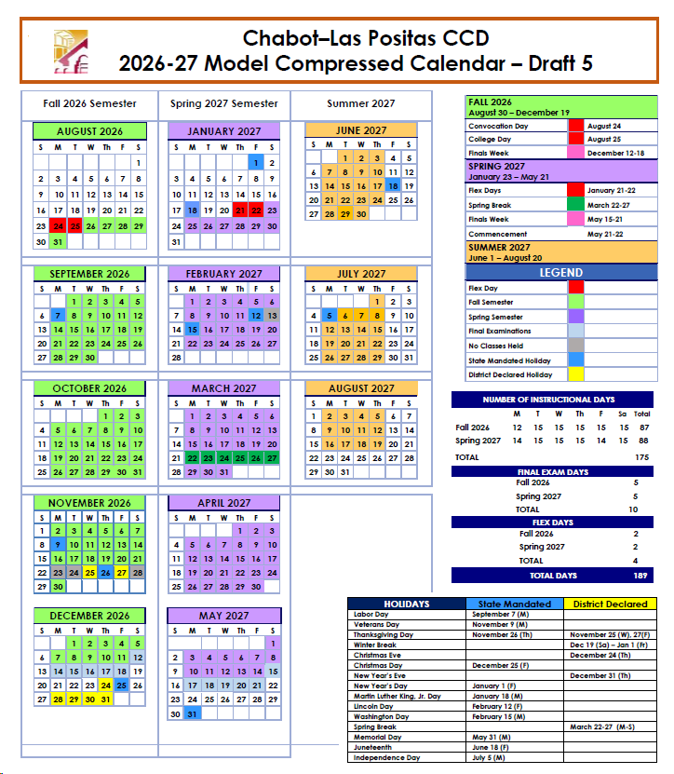
How does class scheduling work under a compressed calendar?
Scheduling options for a full-semester 3-unit lecture course on a 16-week compressed calendar:
Two meetings per week of 1 hour and 25 minutes, or
One meeting per week of 3 hours and 10 minutes
On a traditional calendar, the course would typically be scheduled with two meetings per week of 1 hour and 15 minutes or one meeting per week of 2 hours and 50 minutes.

Slide 14
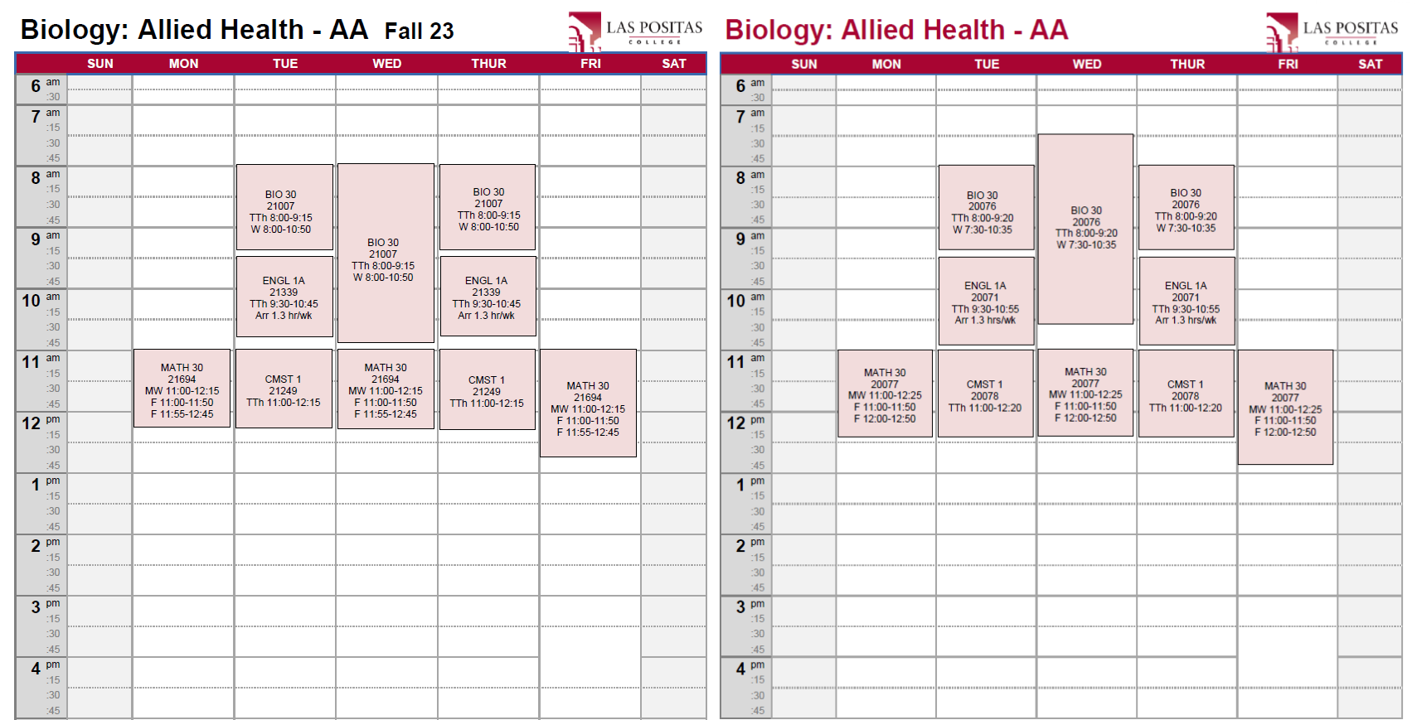
What is a compressed academic calendar?
Compressed
Calendar
CCC regulations permit colleges to compress the same number of hours of instruction into shorter semesters by slightly increasing the number of minutes per class session.

Slide 15
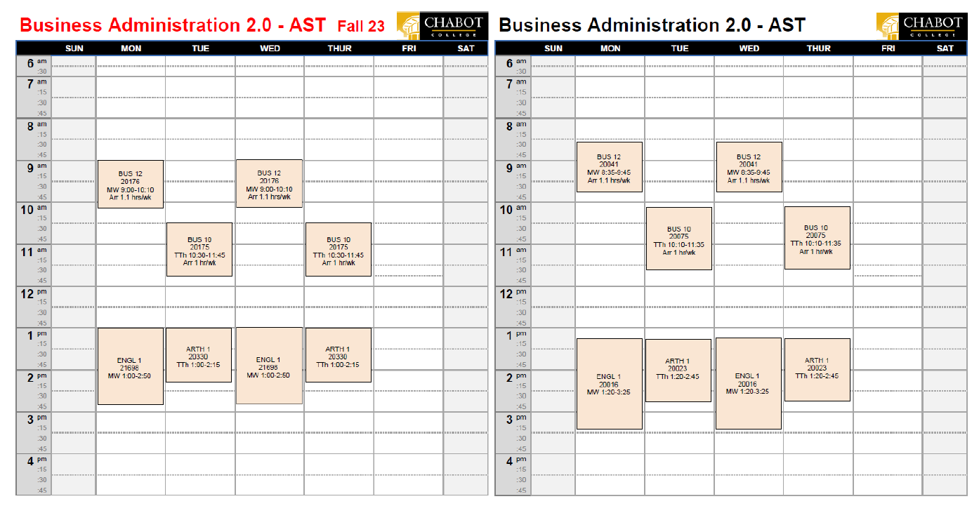
What is a compressed academic calendar?
Compressed
Calendar
CCC regulations permit colleges to compress the same number of hours of instruction into shorter semesters by slightly increasing the number of minutes per class session.

Slide 16
Alternative Academic Calendar Committee
Chabot
LAS POSITAS
DIStRICT OFFICE
Jason Ames - Faculty (Co-Chair)
Safiyyah Forbes - Administrator Paulette Lino – Administrator
Patricia Shannon - Faculty
Rob Yest – Faculty
Megan Parker – Classified Senate Noell Adams - Classified Professional Theresa Pedrosa - Student Senate
Nan Ho - Administrator
Joel Gagnon - Administrator
Scott Miner - Faculty
Dana Nakase - Faculty
Craig Kutil – Faculty
Jason Maxwell – Classified Senate
David Rodriguez - Classified Professional
Isabella Qiu - Student Senate
Theresa Fleischer Rowland (Co-Chair) Liem Huynh - Classified Professional
RESOURCE MEMBERS (non-voting)
Dale Wagoner - Administrator, CC
Tamica Ward, - Administrator, LPC
Bruce Griffin - Administrator, DO
Estella Sanchez - ESSS Executive Asst.
John Mullen (Consultant)

Slide 17
Alternative Academic Calendar Committee
The AACC was formed in Fall 2022 with members carefully selected to represent key stakeholder groups, contribute expertise, and ensure consistent and committed participation.
Co-chairs are Vice Chancellor Theresa Fleischer Rowland and Chabot Communications Studies Instructor Jason Ames.
AACC members include students, faculty, classified professionals and administrators from Chabot, Las Positas and the District Office.
Support is provided by District-contracted professional experts John Mullen and KNow Research.
Detailed information about the work of the AACC is provided on its website: https://clpccd.org/altcalcommittee/

Slide 18
Alternative Academic Calendar Committee
The committee is charged with “examining in detail the benefits and liabilities involved with any modification to the standard 17.5-week semester primary term.” (FA Contract Article 8D)
In consultation with students, faculty, classified professionals, and administrators across the District, the AACC is studying the pros and cons of adopting a compressed academic calendar.
By 2022-23, 68 California Community Colleges had converted to a compressed academic calendar.

Slide 19
What are the key steps?
Information Gathering and Discussions
Districtwide Forums
Impact Surveys
Student Focus Groups
Data Analysis
Recommendation

Slide 20
What are the key steps?
Information Gathering and Discussions
Districtwide Forums
surveyS, FOCUS GROUPS, ANALYSIS
Effects of calendar compression on students’ daily schedules, learning and well-being.
Experience at colleges that have adopted a compressed calendar
Anticipated fiscal and facility utilization changes
Changes in staffing and workload patterns
In-person and virtual presentation and discussion forums
Participation by students, faculty, classified professionals and administrators
Attendees learn details and discuss the pros and cons of adopting a compressed academic calendar
Comprehensive online surveys will enable members of all stakeholder groups to express their opinions and preferences.
Four student focus groups will allow for deeper student engagement.
Detailed analysis of survey and focus group results will inform the AACC as well as the District community.

Slide 21
Recommendation
The AACC will recommend to the District Chancellor whether to request approval from the CCC Chancellor’s Office to adopt an alternative academic calendar for Chabot and Las Positas Colleges in a future year.
The recommendation will be based on information gathered from all sources, including forum discussions, analysis of the impact surveys and focus group responses, and consultation with the leaders of the major stakeholder groups.
This recommendation, targeted to be submitted in December 2023, will complete the work of the Alternative Academic Calendar Committee.

Slide 22
Compressed Calendar Forum
CHABOT
LAS POSITAS
COMMUNITY COLLEGE DISTRICT
Alternative Academic Calendar Committee (AACC)
Chabot College
Las Positas College
District Office
Compressed Calendar Impact Surveys
of Students and Staff
November 6–13, 2023

