Slide 1
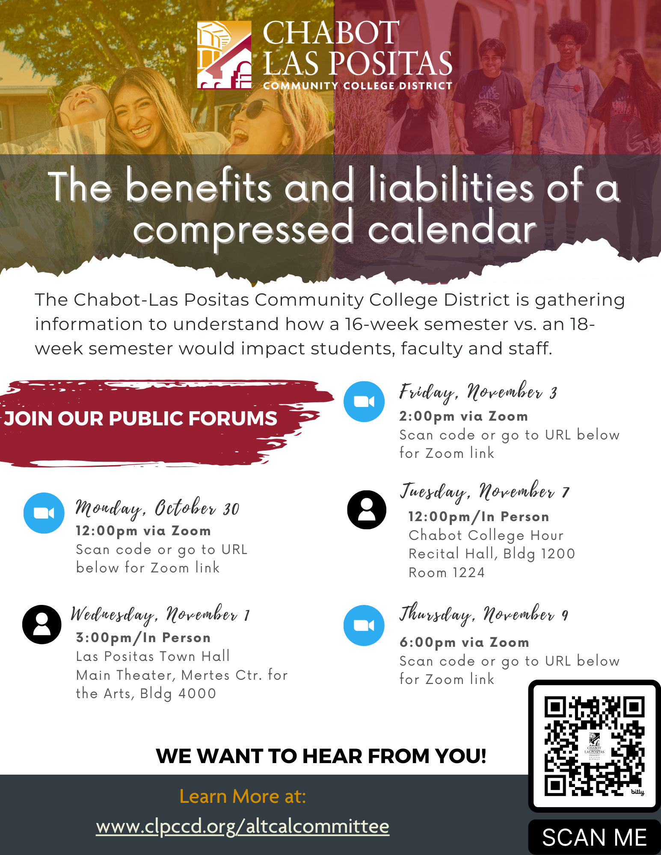
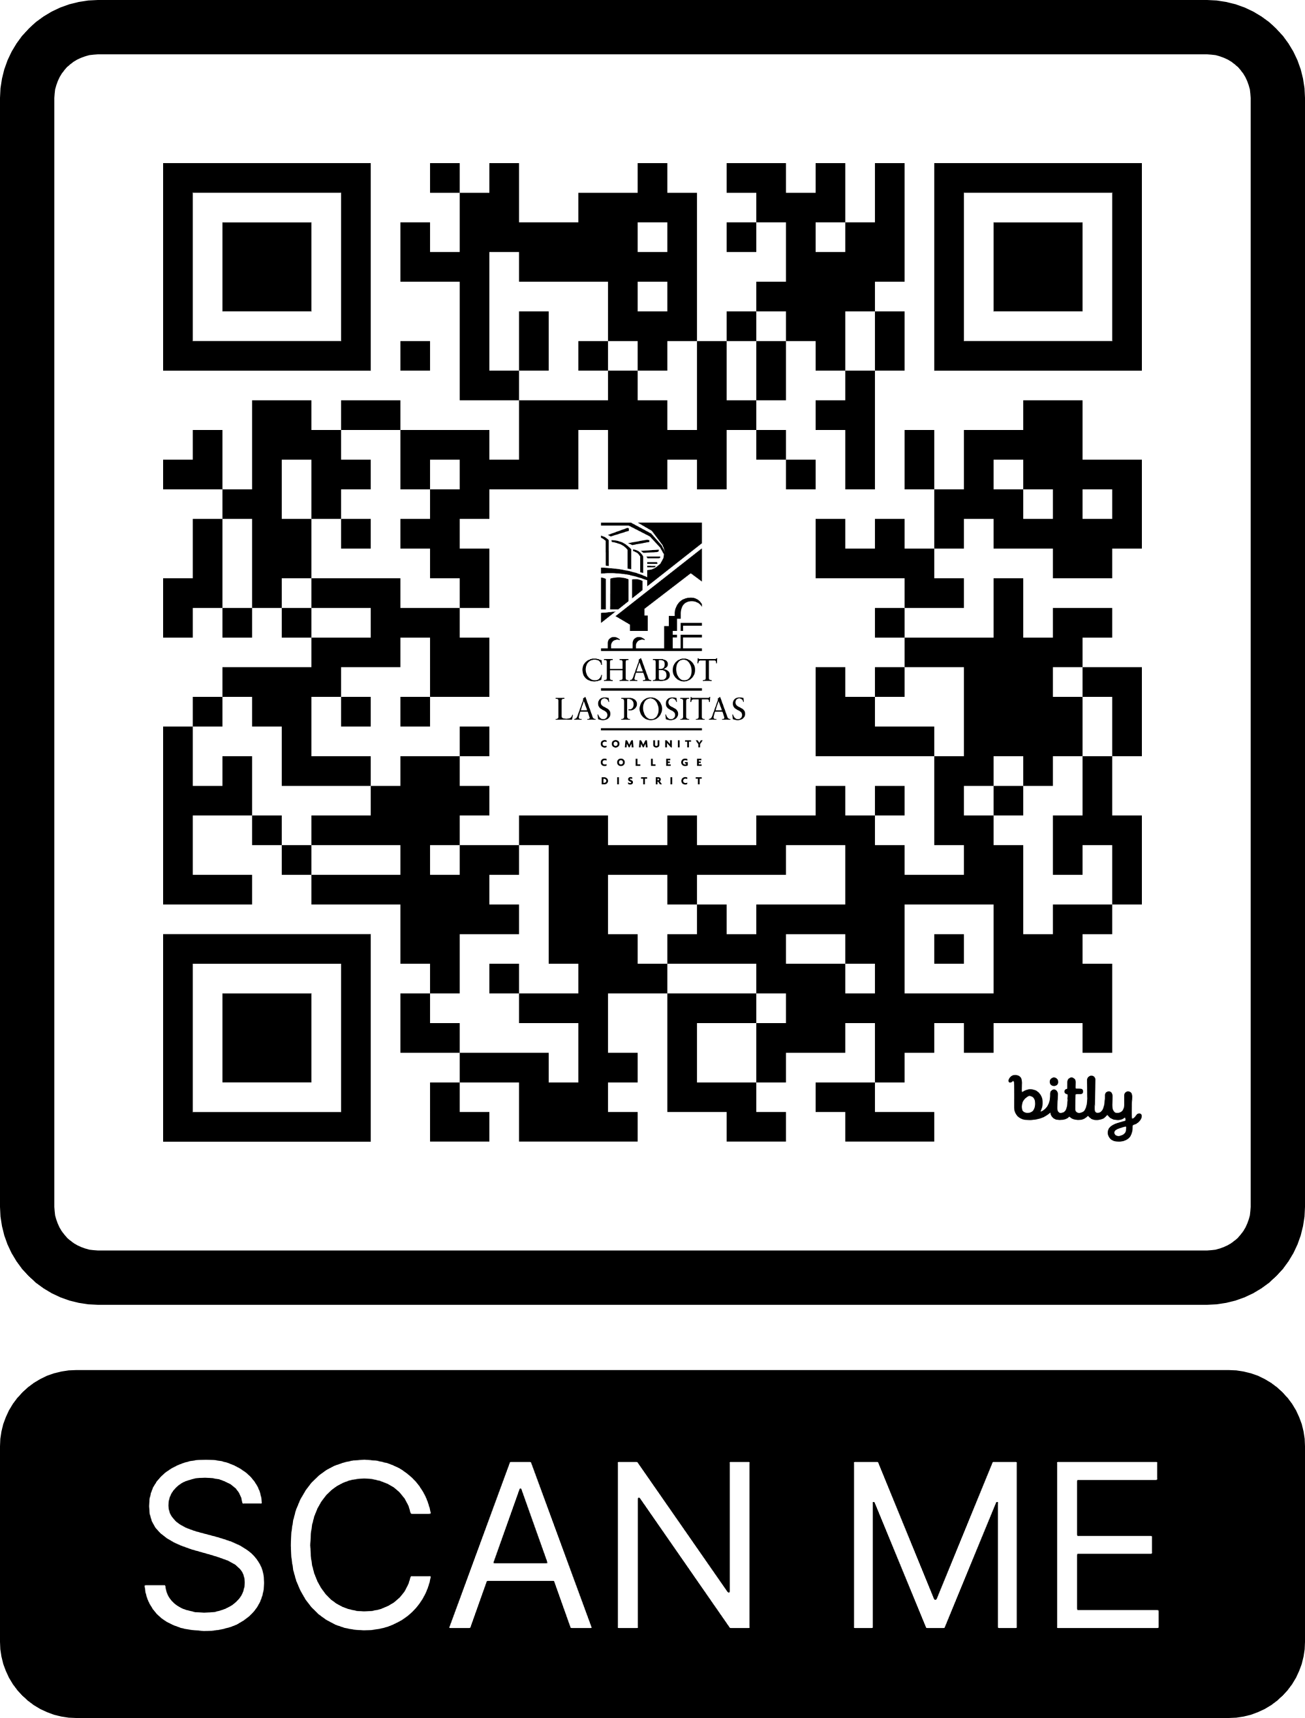
Compressed Calendar Join a Public Forum to Share Your Feedback
Monday, October 30 @ 12:00 PM via Zoom
Wednesday, November 1 @ 3:00 PM In Person
Las Positas College Town Hall in the Main Theater, Mertes Center for the Arts, Bldg 4000
Friday, November 3 @ 2:00 PM via Zoom
Tuesday, November 7 @ 12:00 PM
Chabot College Hour in the Recital Hall, Bldg 1200, Room 1224
Thursday, November 9 @ 6:00PM via Zoom

