Slide 1
Counseling Data Dashboard
Sadie Ashraf, Joel Gagnon & Patricia Molina
Student Services Deans
Notes:
Dr. Rowland introduce the dean team

Slide 2
22-23 Dashboard Workgroup
Members
Sadie Ashraf
Joel Gagnon
Dara Greene
Michael Lai
Christina Lee
Emmanuel Lopez
Heather Oshiro
Patricia Molina
Rafael Valle
Consultation W/
Cynthia Gordon da Cruz
Rajinder Samra
Rachel Ugale
Purpose
Better understand Counseling demand /capacity
Inform scheduling i.e data driven scheduling decisions
Inform resource requests
Inform marketing and outreach decisions
Notes:
Sadie introduce. Thank you Workgroup, IT, and VC Rowland for her leadership.

Slide 3
Workgroup Approach
Parallel CEMC objectives (i.e. productivity and planning)
Track capacity to meet student demand Appointments, drop-ins, SEP completion
Utilize existing and reliable data sources
Include user training
Notes:
Sadie describe approach

Slide 4
Metrics Identified
Metric #1: Student Contact Rate
i.e. Number of students seen / Available counselor hours
Metric #2: Comprehensive SEP Rate i.e. Percentage of new students w/SEPC
Example: First week at Chabot College in General Counseling, 300 students were seen with an available 150 Counselor Hours. Student Contact Rate = 2.0
Example: Athletic Counseling at Chabot College makes Comprehensive SEPs with 190 of its 240 student athletes by the Oct 15th eligibility deadline.
Week 9 SEP Rate = 80%
Notes:
Sadie describe metrics and disagg strategies

Slide 5
Data Disaggregation
By Pathway
By Program
Time-Frame Reporting (similar to CEMC)
Week by Week
Term (Summer, Fall, Spring)
Year over Year
Notes:
Sadie describe metrics and disagg strategies

Slide 6
Sample Prototypes – Warning
Actual Dashboards are still in development
The following prototypes contain
Made-up data
Empty Data Sets
Incomplete disaggregation
The real dashboard will be even better

Slide 7
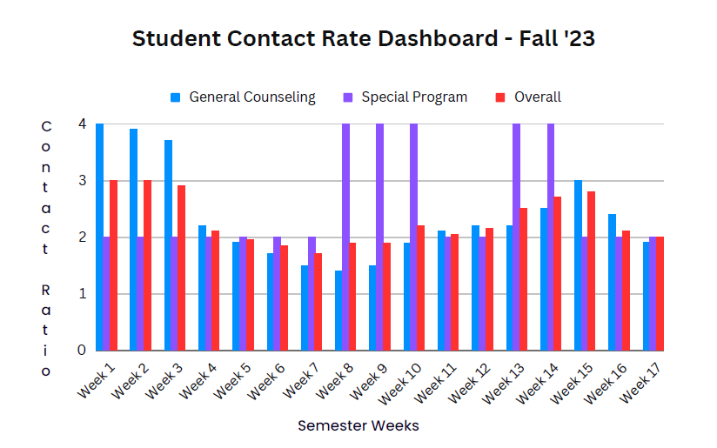
Dashboard Prototype (Metric #1)
Notes:
Joel introduce prototype Metric #2

Slide 8
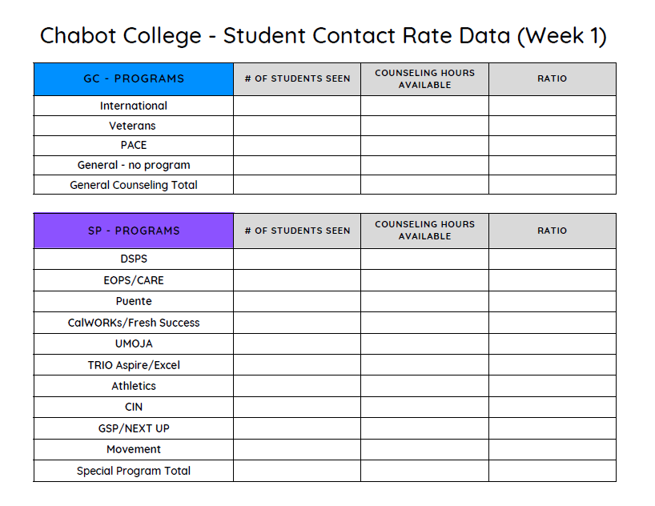
Data Points
Notes:
Joel

Slide 9
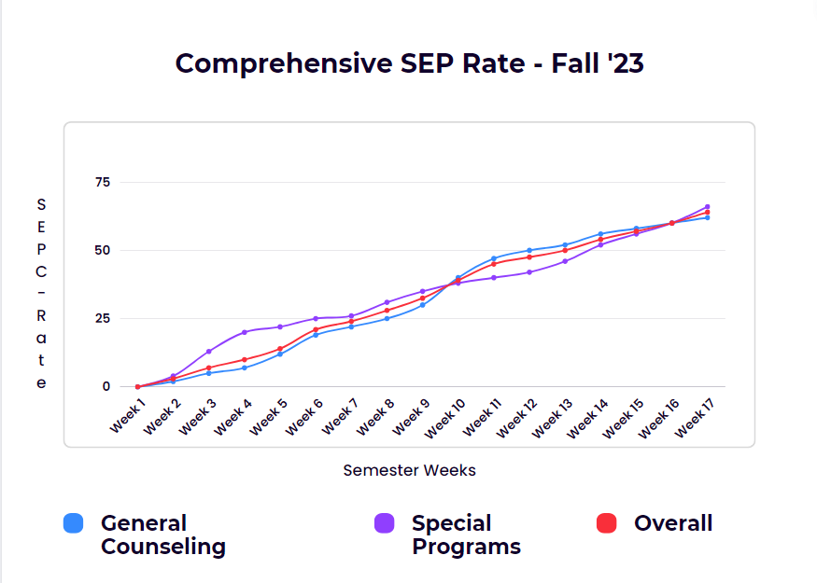
Dashboard Prototype (Metric #2)
Notes:
Patricia introduce prototype for Metric #1

Slide 10
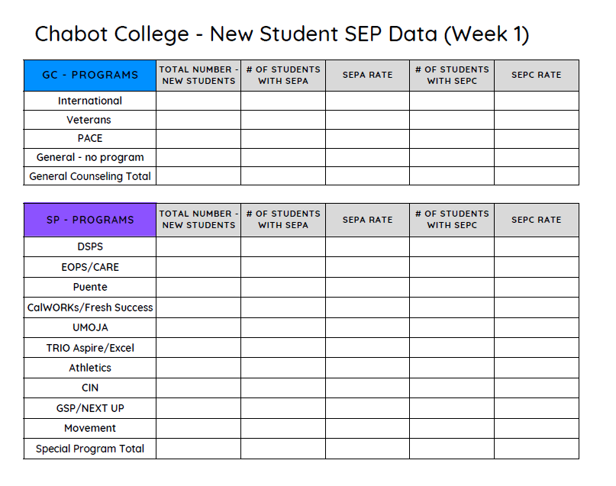
Data Points:
Notes:
Patricia

Slide 11
Work Remaining
Continued Data Clean-up
IT Dashboard Development (Ellucian Advise?)
Data Automation e.g. Degree Works SEP data reporting
Training
Additional data exploration (i.e. V2.0, V3.0, etc.)
Abbreviated SEP tracking
Unmet need
Undecided majors/ ed goals
Notes:
Joel explain the work remaining

Slide 12
Thank you!
Questions?
Comments?
Notes:
Sadie thank the group and ask if there are questions

