Slide 1
25-26 Counseling Discipline Plan
Joel Gagnon & Cristine Sidela
Student Services Deans
5/2/25

Slide 2
Counseling Discipline Plan - Expectations
Goals and Targets
Optimizing SCFF
Activities & Timelines
Accountability Strategies

Slide 3
Goals and Targets
Student Contact Hour Availability (+ or -)
SEPCs Completion (100%)
Appointment / Drop-in Ratio (70% in GC)
Drop-in students seen / Hour ( 2 – 3 )

Slide 4
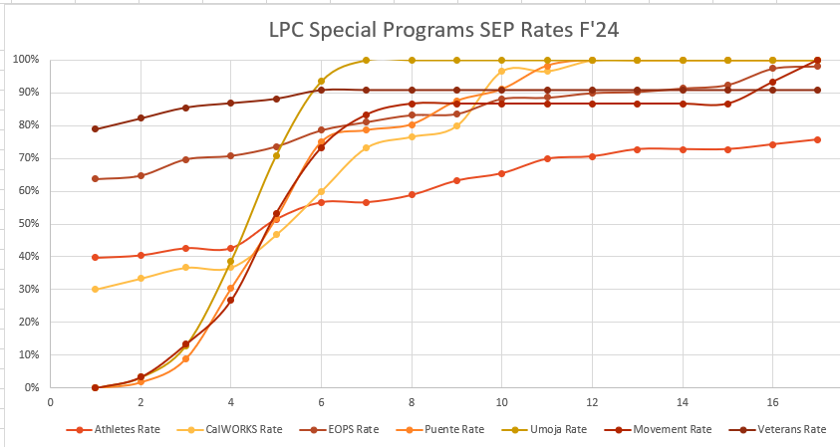
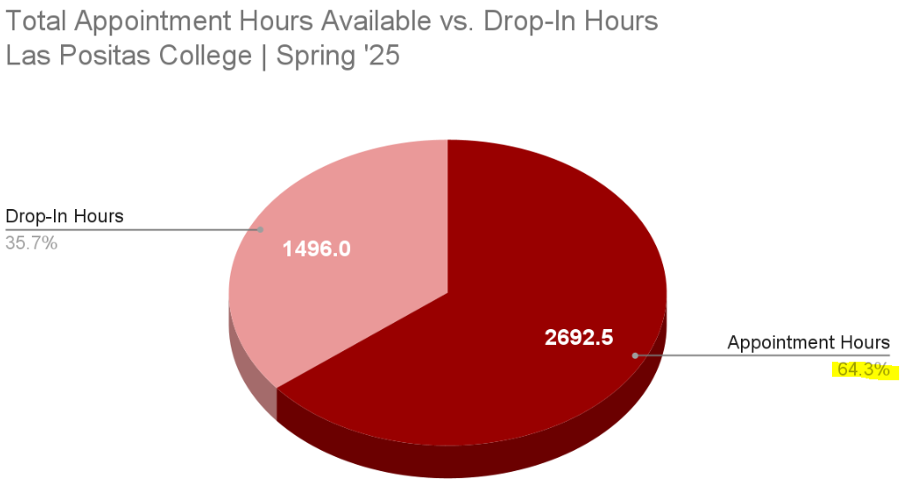
Goals and Targets

Slide 5
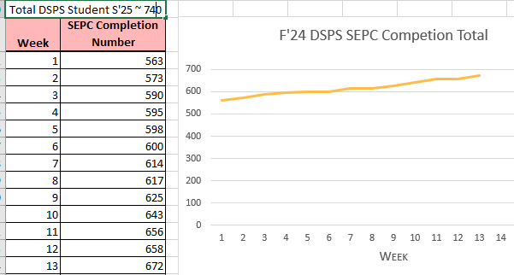
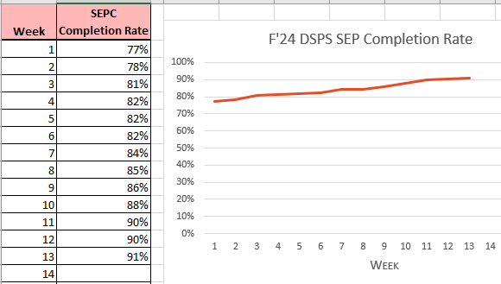
Optomizing SCFF – SEPC Completion (Program)
General Counseling - ~65%
DSPS – 90%
Middle College / MESA - 100%
EOPS/CARE/CalWorks - ~98%
Learning Communities – 100%

Slide 6
Activities and Timelines
Increase First Semester Planning (FSP) sessions
Summer FSP Days
Athletic Eligibility Week
Operation Gateway (Veterans)
Prospective Student Counseling (Special Programs)
New Hawk Day (500+ students Sp’25)

Slide 7
Accountability Strategies
Data Driven Decisions
Number of Unfilled appointments
Drop-in rate (replace with SEPC appts)
Assigned Drop-in
Increased # of students/hour
Known wait times for students
Data informed overload and part-time allocation

Slide 8
Accountability Strategies
Appointment to Drop-in Ratio
New Student vs Continuing Student SEP
First-Time SEP vs Follow-up SEP
SEPC In-Reach
Counselor Proactive Time
Email Campaigns
Call Campaigns
Notes:
Joel explain the work remaining

Slide 9
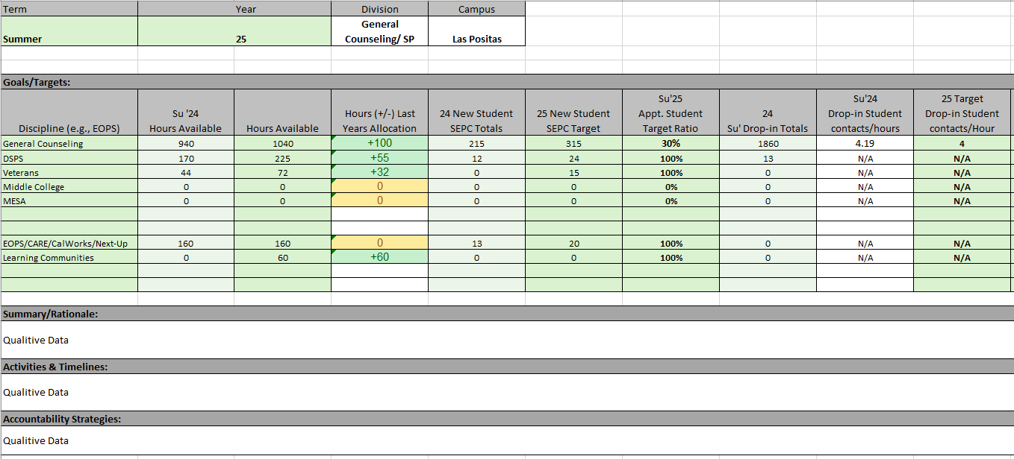
The Discipline Plan

