Slide 1
Facilities Modernization Program
Funded by Measure A
Project Report
April 28, 2021

Slide 2
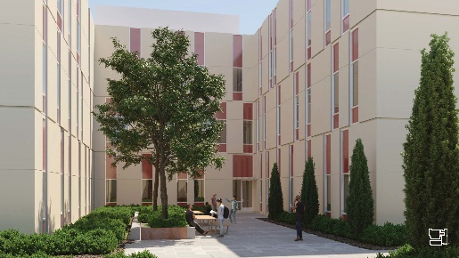
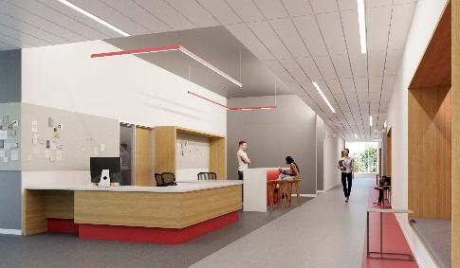
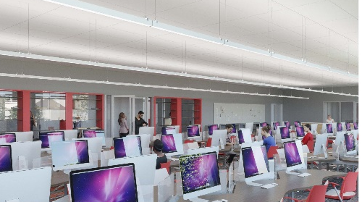
PROJECT PROGRESS REPORT
B2100 New Academic Support and
Office Building
LAS POSITAS COLLEGE
April 28, 2021
Project Team:
Architect: LPAS
Project / Construction Manager: Swinerton Management & Consulting
Contractor: Flint Builders, Inc
Project Description:
The new Academic Support and Office building will be built in the location of existing buildings 2100 & 2200. The project consists of the following elements and programs: English Center incorporating classrooms, computer lab, tutoring and study areas. Math Center incorporating classrooms, labs and the Math X program. Computer Sciences Center including computer labs, networking, maker space and open labs with the expanded of library functions including reference desk, study areas, computer lab, expanded staff offices and library operational support spaces. Faculty Offices, Dean’s suite and support spaces will also be in the building.
Project Update:
Submission of Construction Documents to DSA happened in late October 2020 for review and comment. The Lease-Leaseback Contractor is working on constructability reviews, subcontractor bidding, with key subcontractors selected to work with the team during the Preconstruction phase. Current estimates show that the project is trending within budget. Estimated construction start is summer of 2021.
Design COMPLETED
DSA Approval: Summer 2021
Construction Start Summer 2021
Occupancy Fall/Winter 2023

Slide 3
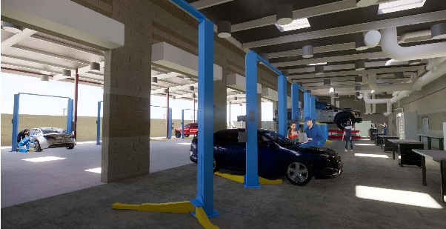
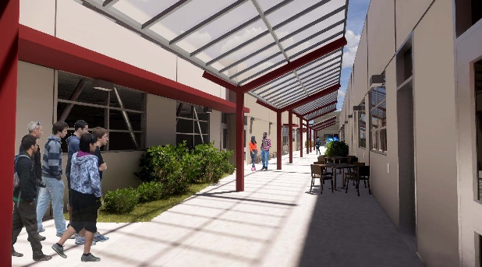
PROJECT PROGRESS REPORT
Public Safety Complex /
Advanced Manufacturing and Transportation
LAS POSITAS COLLEGE
April 28, 2021
Project Team:
Architect: Lionakis
Project / Construction Manager: Vanir Construction Management
Contractor: Overaa
Project Description:
The new Public Safety Complex (PSC) and Advanced Manufacturing and Transportation (AMT) building will be co-located to allow for shared linkages between the various programs, classrooms and event spaces. The building will be built near the existing sports fields in the northeastern portion of the upper campus. The PSC project consist of the following elements and programs: EMS Simulation Lab and Situation Rooms, and Fire Training with Class A burn areas. The AMT project will include an automotive tech facility, welding lab, and classroom and lab spaces to provide training of advanced manufacturing processes. Faculty Offices, Dean’s suite and support spaces will also be included in the project.
Project Update:
Submission of DSA back-check construction documents for Increment 1 occurred in March 2021 for review and approval. DSA has returned with comments, the Increment 2 construction documents for the design team to review, update and resubmit to DSA for approval in mid-May 2021. Lease-Leaseback contractor has started the subcontractor bidding process. Final GMP negotiations anticipated to take place with the District by end of May 2021. Team expects to take the Final GMP for Board Approval at the June 2021 Board Meeting. Estimated construction start is summer of 2021.
Design Completed
DSA Approval: Summer 2021
Construction Start Summer 2021
Occupancy Winter 2023

Slide 4
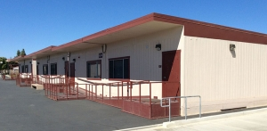
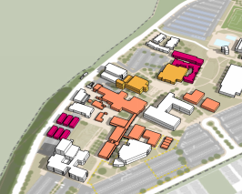
PROJECT PROGRESS REPORT
Temporary Office Complex - Faculty Office Relocation Village
LAS POSITAS COLLEGE
April 28, 2021
Sample Elevation
Project Team:
Architect: LPAS
Construction Manager: Vanir Construction Management, Inc.
Contractor: Sausal
Project Description:
The project includes providing modular buildings to accommodate ~ 75 faculty offices, conference rooms, support spaces and a modular restroom unit to support the occupants. A raised, covered walkway with ramps will be provided to connect the modular buildings and restroom unit.
Project Update:
Construction started January 2021. Modular buildings are in place and substantially completed. Site contractor is completing decking, electrical, data and miscellaneous site. Faculty relocation from B2100 will take place the first week of June 2021.
Design COMPLETED
DSA Approval: COMPLETED
Construction Start: January 2021
Occupancy: May 2021

Slide 5
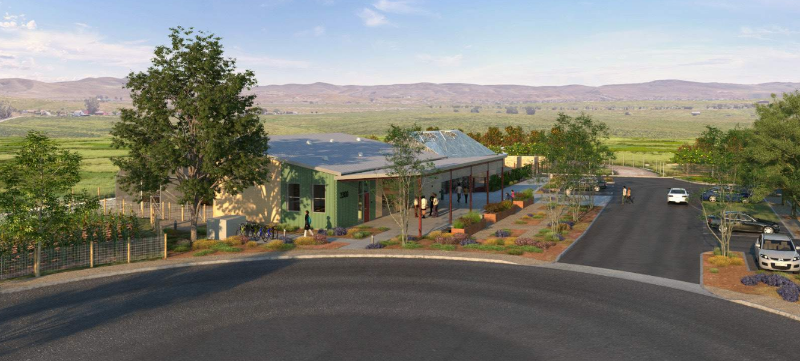
PROJECT PROGRESS REPORT
AG SCI: Horticulture Facility Project
LAS POSITAS COLLEGE
April 28, 2021
Project Team:
Architect: ATI Architects and Engineers
Construction Manager: Roebbelen (RCMS)
Contractor: Overaa
Project Description: The New Horticulture Facility will replace the facilities currently located in Building 800 and located outdoors and be located near the Maintenance and Operations facility and the Track and Field at the upper NE part of campus. The project includes, additional parking for a 75 space parking lot for faculty and students. The Horticulture Facility includes a classrooms, Labs, offices and resource area, a greenhouse, shade structures. The outdoor growing areas will have soil bins, equipment storage and an outdoor learning patio.
Project Update:
Bidding and selection of General Contractor occurred in March of 2021. Apparent lowest bidder will be submitted to the April Board for approval of contract. Construction is anticipated to start in May 2021. Estimated occupancy is Fall Semester of 2022.
Design COMPLETED
DSA Approval COMPLETED
Construction Start May 2021
Occupancy Summer/Fall 2022

Slide 6
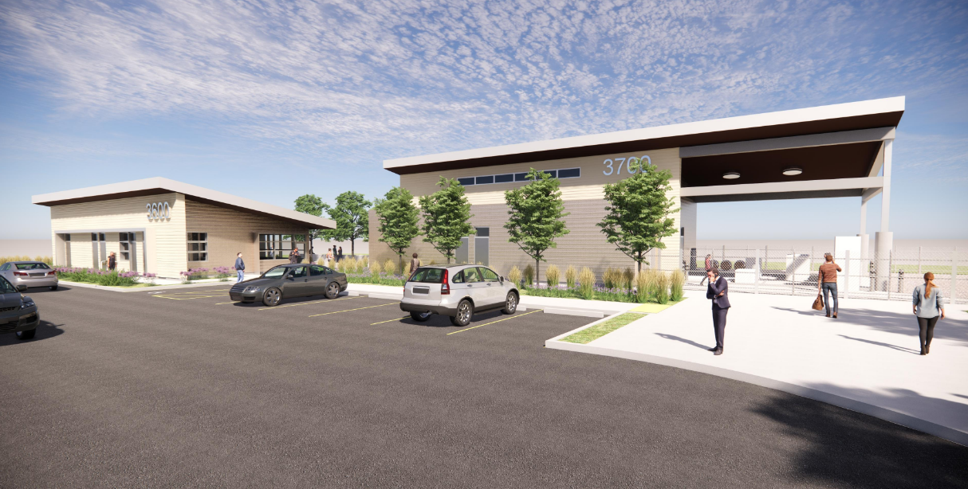
PROJECT PROGRESS REPORT
AG SCI: Viticulture Facility Project
LAS POSITAS COLLEGE
April 28, 2021
Project Team:
Architect: tBP/Architecture, Inc.
Construction Manager: Roebbelen (RCMS)
Contractor: TBD
Project Description: The New Viticulture Facility will replace the existing facilities currently located in/outside of Building 800. The Viticulture Facility will be located at the main entrance off the Campus Hill Road. This new roadway will connect the new facilities into the existing campus. The new facility will be developed at a higher elevation allowing for expansive views. The project will be include general site grading and utility infrastructure; New Roadway and Pedestrian pathways connecting to the existing campus. A Visitor Center with Tasting room, visitor Parking and clear paths of travel, A Winemaking Facility including classrooms and Labs, office and resource areas, Crush pad, Equipment storage, cold storage, and an Outdoor Patio.
Project Update:
Design Development Phase finalized the orientation of the buildings in the new location, interior room adjacencies and equipment layouts with the user group was completed. Presentation to the President and Vice Presidents for any feedback prior to authorizing the Design Team took place, with no major comments, nor change requests. Notice to Proceed was granted on April 16, 2021 to the Design Team to move into Construction Document Phase of the project.
Design In Progress
DSA Approval TBD
Construction TBD
Occupancy TBD

Slide 7
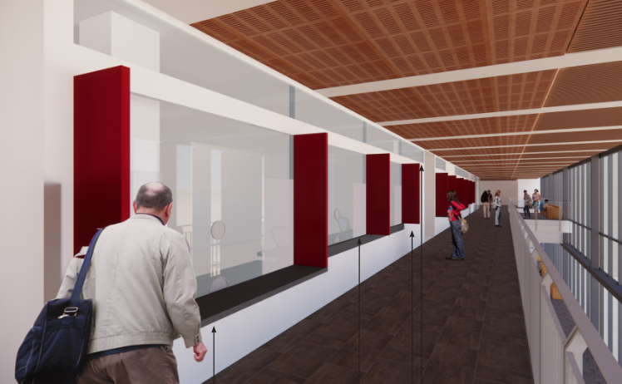
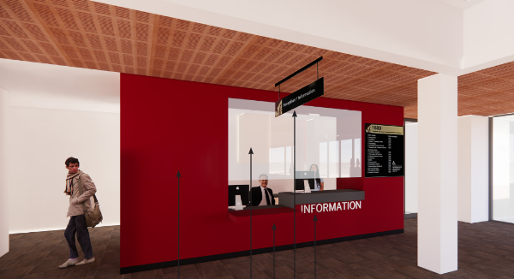
PROJECT PROGRESS REPORT
Architecture Barrier Project
LAS POSITAS COLLEGE
April 28, 2021
Project Team:
Architect: Steinberg Hart
Construction Manager: Roebbelen (RCMS)
Contractor: JD General Construction, Inc.
Project Description:
Improvements to accessible counters, safety and security of service windows at the Student Services & Administration Building. Service windows include: Information Desk, Student Services Center, Financial Aid and Admission and Records.
Project Update:
Currently, the project is in the bidding phase. The apparent lowest bid will be submitted to the May 2021 Board meeting and construction is expected to begin in May 2021.
Design COMPLETED
DSA Approval COMPLETED
Construction Spring 2021
Occupancy Fall 2021

Slide 8
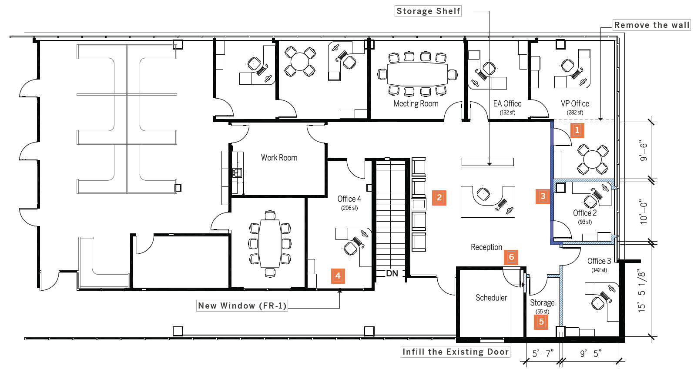
PROJECT PROGRESS REPORT
B1690 Academic Services Renovation
LAS POSITAS COLLEGE
April 28, 2021
Project Team:
Architect: Steinberg Hart
Construction Manager: Roebbelen (RCMS)
Contractor: J.D. General Construction, Inc.
Project Description:
To enhance the functionality of the Academic Services Area. The improvements include: Expansion of the VP’s office, to provide meeting space, three additional offices and smaller storage area, a more inviting reception area with the central area providing space to display collateral materials
Project Update:
Construction of B1690 suite is completed, with minor punch list items taking place. B1690 occupants returned to their offices at the end of March. Final completion of the project is expected May 2021, with Notice of Completion going to the June Board for approval..
Design COMPLETED
DSA Approval COMPLETED
Construction In Progress
Occupancy Spring 2021

Slide 9
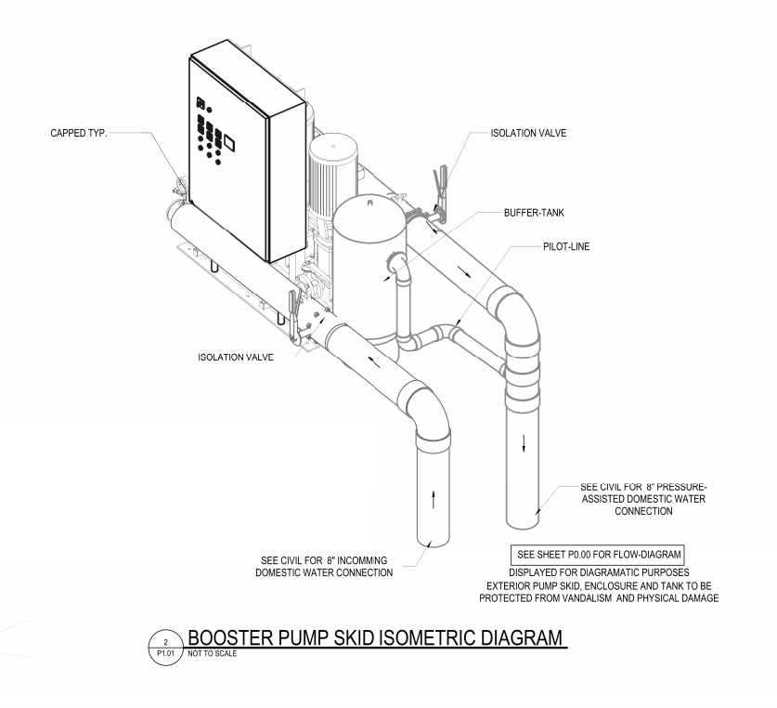
PROJECT PROGRESS REPORT
Domestic Water Booster System Project
LAS POSITAS COLLEGE
April 28, 2021
Project Team:
Architect: Sandis
Construction Manager: Roebbelen (RCMS)
Contractor: TBD
Project Description:
The project is intended to provide a booster pump system to raise the overall campus domestic water pressure. Pressure reducing valves will be installed at selected buildings to prevent overpressure of the plumbing fixtures.
Project Update:
Currently, the project is in the bidding phase. The apparent lowest bid will be submitted to the May Board meeting for approval, with construction expected to begin late May early June 2021.
Design COMPLETED
Construction Spring 2021
Completion Summer 2021

Slide 10
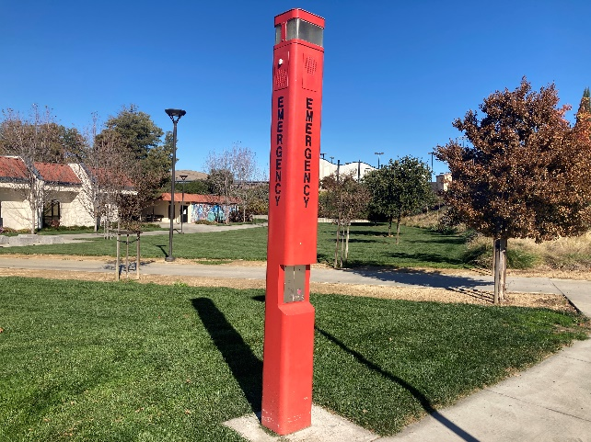
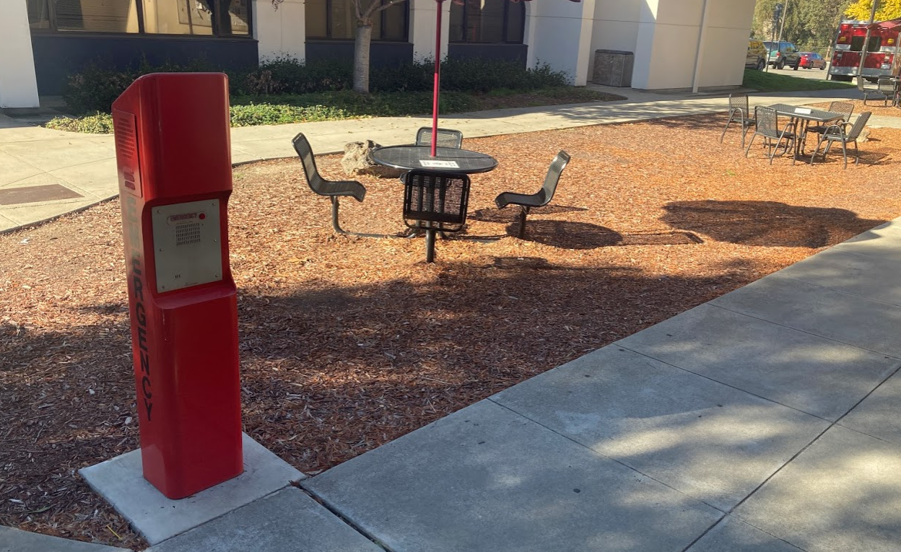
PROJECT PROGRESS REPORT
Emergency Call Station Project
LAS POSITAS COLLEGE
April 28, 2021
Project Team:
Architect: Catalyst Consulting Group, Inc.
Construction Manager: Swinerton Management & Consulting
Contractor: Electronic Innovations
Project Description: The District-wide Emergency Call Station Project comprises of the procurement, installation and programming of new emergency call stations and retrofitting of existing call stations at both the Chabot and Las Positas College Campuses. This project also includes the installation of a new ECS server at the Las Positas Campus to match the existing Zenitel/STENTOFON ICX- 500 server and software at the Chabot Campus. It includes configuration and programming of both the existing Chabot ESC server and the new Las Positas server along with interfacing these servers to the existing Fire Alarm Control Panel at the respective campus to provide communication from the ECS server to the FACP.
Project Update:
Construction Phase: 8 towers removed, retrofitted and replaced at Las Positas Campus. Awaiting CommScope parts. Server room equipment installation in progress.
Design COMPLETED
Construction In Progress
Occupancy Summer 2021

